Slide 1
Learning Scheduling Algorithms
for Data Processing Clusters
Project Group : Artificial Intelligence for Computer Networks
Tejas Ravindra Dhawale
6882910

Slide 2
Contents
Motivation
Introduction to Decima
Decima Design
Graph Neural Network
Policy Network
Training
Evaluation

Slide 3
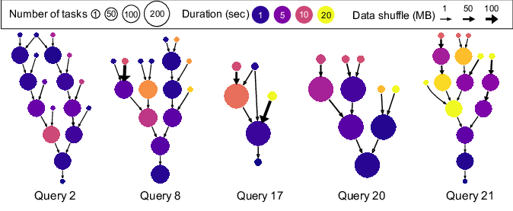
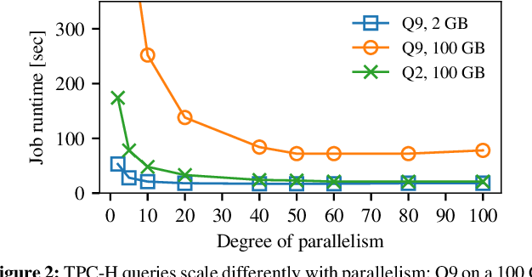
Motivation
Scheduling is a very important part of data processing clusters
Improving the efficiency of the cluster schedulers can save millions of dollars at scale

Slide 4
Introduction to Decima
A Framework for automatically scheduling directed acyclic graph (DAG) structured jobs
Decima uses reinforcement learning (RL) and neural networks to learn workload-specific scheduling algorithms
The key design challenges for Decima:
Scalable state information processing
Huge space of scheduling decisions
Training for continuous stochastic job arrivals

Slide 5
Decima Design

Slide 6
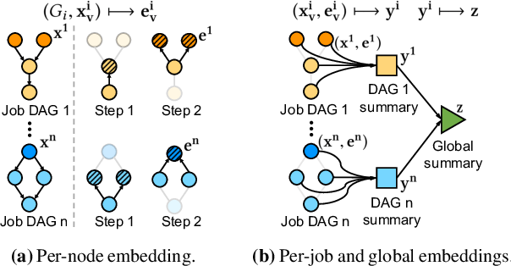
Graph Neural Network
Per-node embedding
Per-job embedding
Global embedding

Slide 7
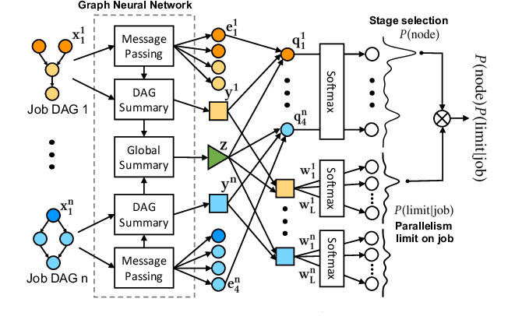
Policy Network
Stage Selection
Parallelism limit selection

Slide 8
Training
Initial random policy
Number of backlogged jobs
Time

Slide 9
Training
Initial random policy
Number of backlogged jobs
Waste training time
Time

Slide 10
Training
Increase the reset time
As training proceeds, the agent learns a good policy
Number of backlogged jobs
Time
Reference: https://web.mit.edu/decima/

Slide 11
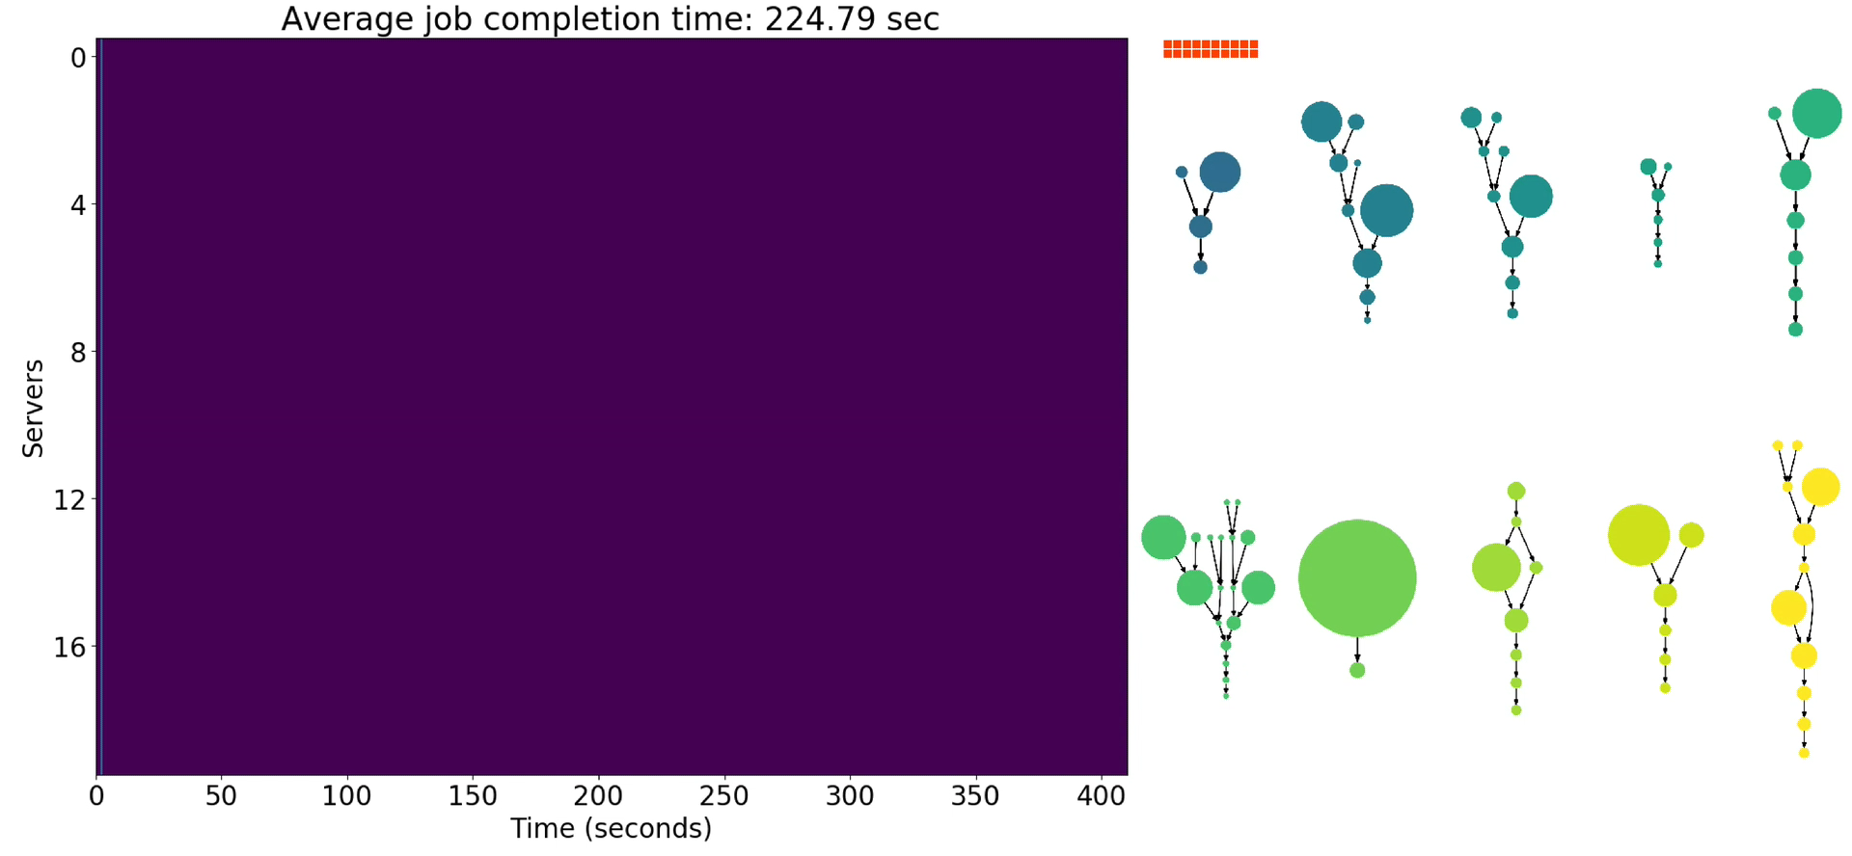
Evaluation: Scheduling policy(FIFO)
Number of servers working on this job
Average Job Completion Time:
225 sec
Reference: https://web.mit.edu/decima/

Slide 12
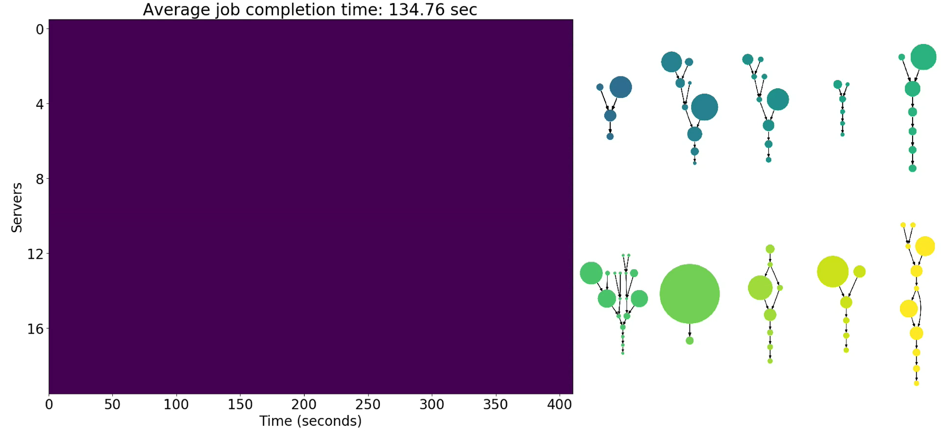
Evaluation: Scheduling policy(Shortest-Job-First)
Average Job Completion Time:
135 sec
Reference: https://web.mit.edu/decima/

Slide 13
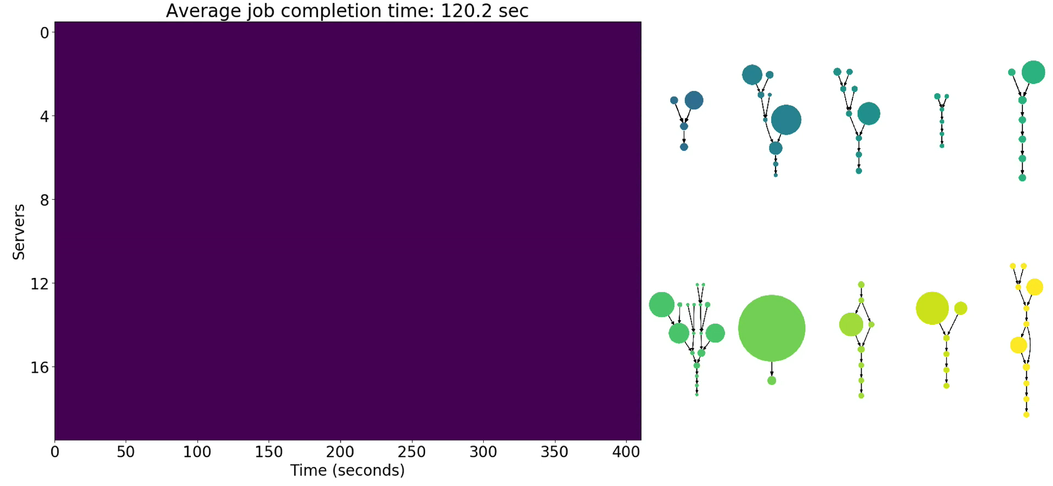
Evaluation: Scheduling policy(Fair)
Average Job Completion Time:
120 sec
Reference: https://web.mit.edu/decima/

Slide 14

Evaluation: Scheduling policy(Decima)
Average Job Completion Time:
98 sec
Reference: https://web.mit.edu/decima/

Slide 15
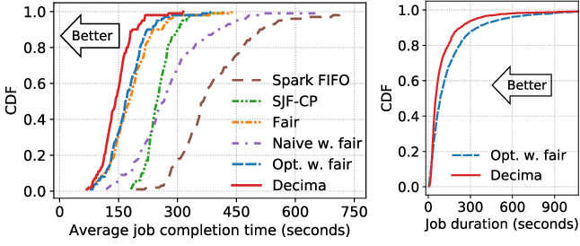
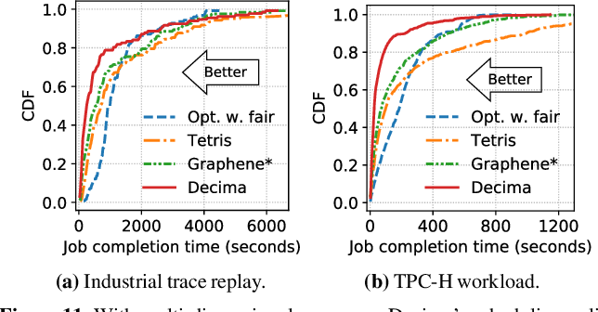
Evaluation
(a) Batched arrivals
(b) Continuous arrivals
(c) Multi-dimensional
resource
Reference: https://web.mit.edu/decima/

Slide 16
THANK YOU

